Slide 1

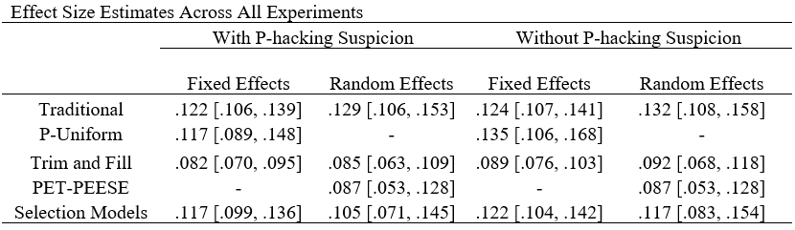
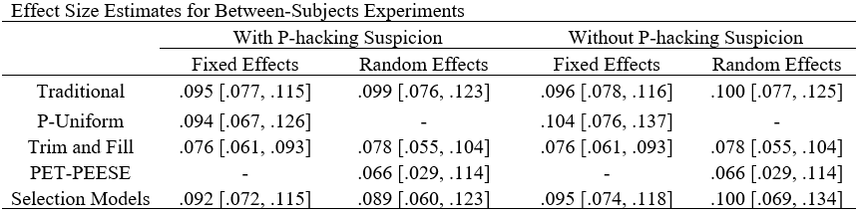
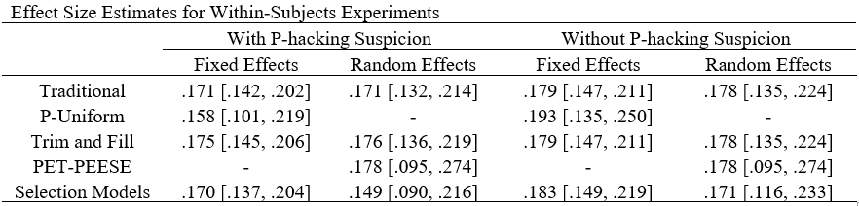
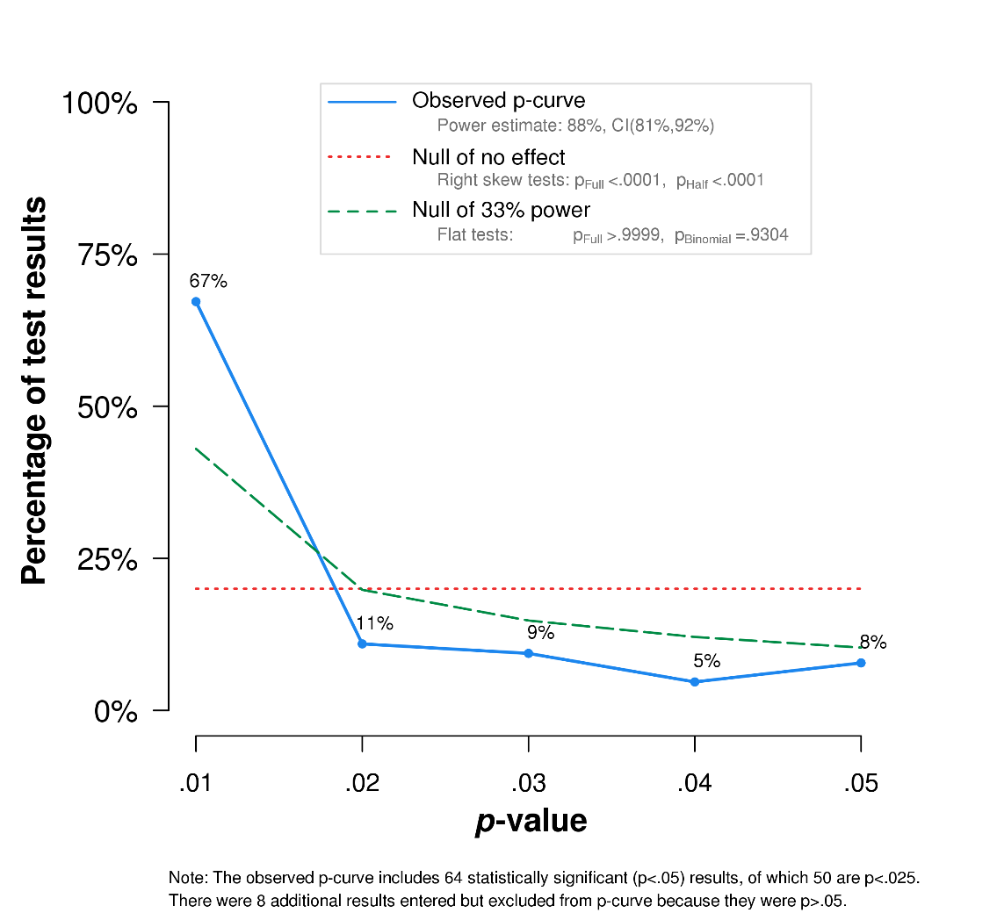
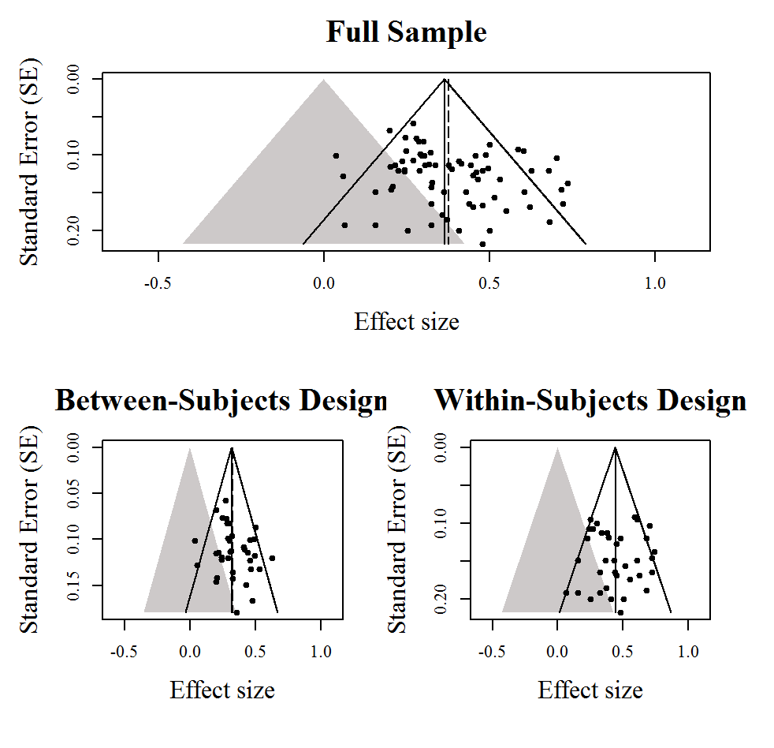
A Meta-analysis of the Survival Processing Advantage in Memory
John E. Scofield, Erin M. Buchanan, Bogdan Kostic
Missouri State University
Abstract
The survival processing advantage occurs when processing words for their survival value improves later performance on a memory test, which has significant adaptive value. Traditional meta-analytic methods were used, as well as p-curve, p-uniform, trim and fill, PET-PEESE, selection models, and the test of excessive success (TES) to investigate pooled effect size estimates and potential small-study effects. All materials, including datasets and R code are available online at osf.io/6sd8e. Bias-correction techniques tend to lower effect size estimates. Interestingly, effect size estimates are higher with suspected p-hacking experiments excluded.
Results
Note: The tables to the left shows effect size estimates across all experiments, for between-subjects experiments, and for within-subjects experiments along with 95% confidence intervals for various types of research synthesis analyses, with the last four techniques correcting for selective reporting. All effect size estimates are reported with suspected p-hacking experiments included in the analysis compared to when suspected p-hacking experiments are excluded from the analysis to compare changes in effect size estimates in the presence of p-hacking.
Supplemental Materials
Supplemental materials, as well as all materials, datasets, and R code is available at:
http://osf.io/6sd8e
Contact: John Scofield (John1551@live.missouristate.edu)
Method
Experiments
75 experiments which were acceptable for inclusion in this analysis. 21 experiments were excluded from this analysis (insufficient quantitative information or differing measures of interest). 49.33% of experiments (37) utilized a between-subjects design and 50.67% (38) utilized a within-subjects design.
Procedure
All effect sizes were recalculated, and partial eta squared was chosen as the effect size of interest. Effect sizes were weighted in terms of their inverse variance.
Homogeneity of effect size parameters were assed using the Q-statistic and the I² index. Statistical power was calculated using statistics reported in experiments.
Experiments with suspicion of p-hacking were flagged (combination of power lower than .60 and p-values between .025-.05). Pooled effect size estimates were compared between the presence and absence of suspected p-hacking.
TES was applied to all studies with four or more experiments. A p-curve and p-uniform analysis was analyzed which examines p-value distributions of statistically significant findings and tests if sets of studies contain evidential value.
Trim and fill methods were used to examine the relationship between effect sizes and standard error. The use of PET-PEESE also tests for funnel plot asymmetry and yields effect size estimates. Selection models were also applied to yield effect size estimates while correcting for selective reporting.
Average effect size estimates were computed for three groups: Across all experiments, and with two more homogeneous subgroups according to research design.
Effect size estimates were compared with these different bias-correction techniques.

